Slide 1
SE 6387 – Advanced Software Engineering Project
CometPark
Arunkumar Manickam
Hariprasad Natarajan
Prasanna Venkatesh Venkitasamy
Rekha Muthulakshmi Nachadalingam

Slide 2
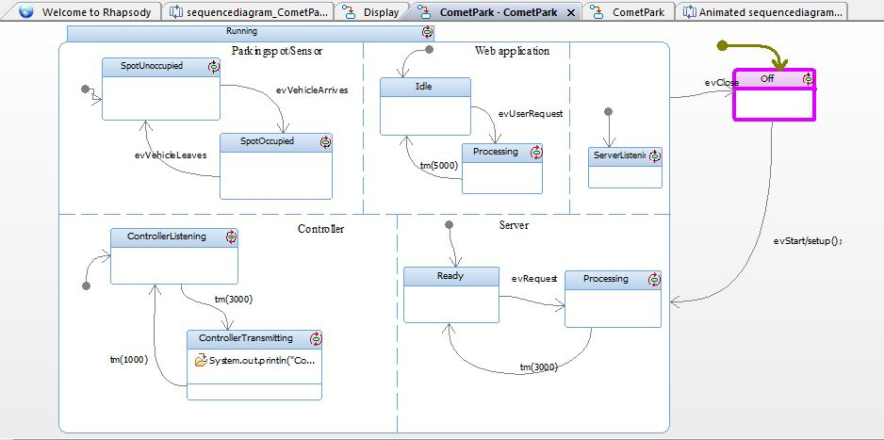
System State: Off State

Slide 3
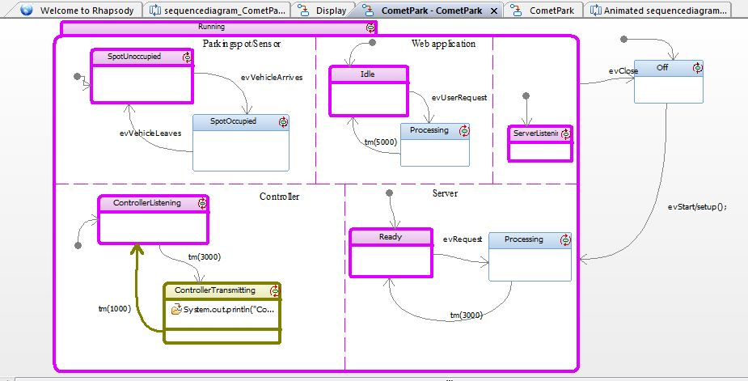
System State: Running

Slide 4
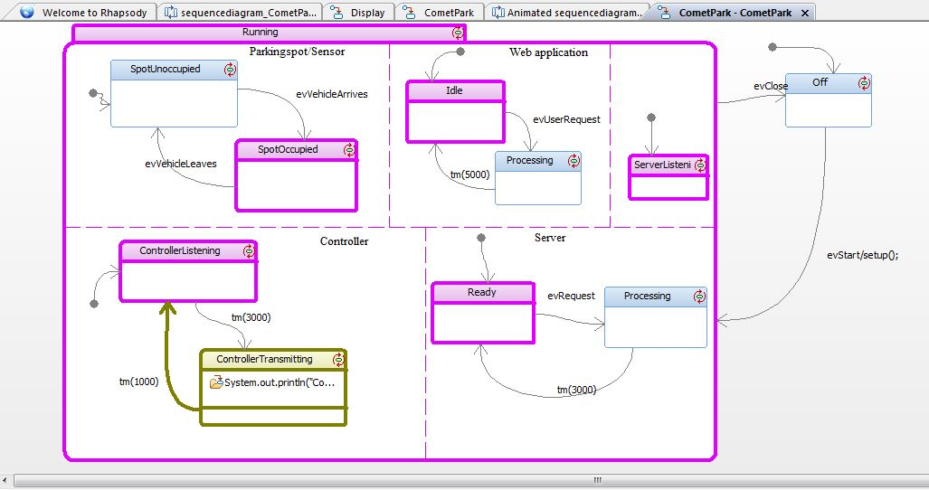
System State: Vehicle Arrives

Slide 5
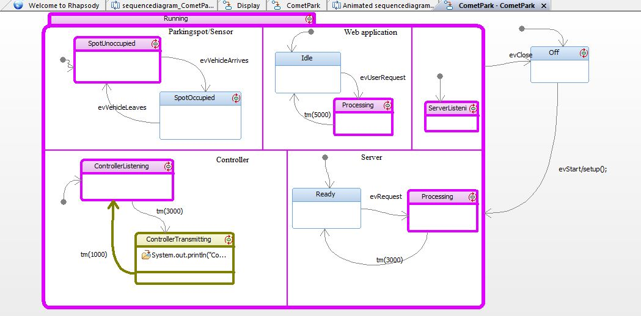
System State: User Request

Slide 6
THANK YOU !

